Slide 1
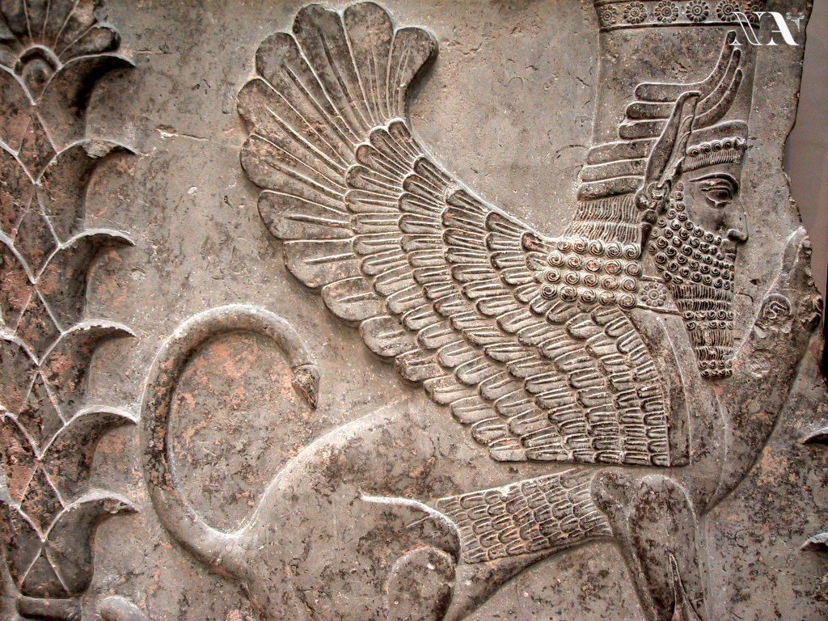


Slide 2
STANDARD WHI.3a
The student will demonstrate knowledge of ancient river valley civilizations, including those of Mesopotamia, Egypt, the Indus River Valley, and
China and the civilizations of the Hebrews, Phoenicians, and Nubians, by
locating these civilizations in time and place.
During the New Stone Age, permanent settlements appeared in river valleys and around the Fertile Crescent.
River valleys provided water and rich soil for crops as well as protection from invasion.
River valley civilizations (about 3500 to 500 B.C.[B.C.E.])
• Mesopotamian civilization: Tigris and Euphrates River Valleys (Southwest Asia)
• Egyptian civilization: Nile River Valley and Nile Delta (Africa)
• Indian civilization: Indus River Valley (South Asia)
• Chinese civilization: Huang He Valley (East Asia)
These river valleys offered rich soil and irrigation water for agriculture, and they tended to be in locations easily protected from invasion by nomadic peoples.
Other early civilizations (about 2000 to 500 B.C.[B.C.E.])
• Hebrews settled between the Mediterranean Sea and the Jordan River Valley (part of Fertile
Crescent in Southwest Asia).
• Phoenicians settled along the Mediterranean coast (part of Fertile Crescent in Southwest Asia).
• Nubia was located on the upper (southern) Nile River (Africa).

Slide 3
b) describing the development of social, political, and economic patterns, including slavery.
River valleys were the “Cradles of Civilization.” Early civilizations made major contributions to social, political, and economic progress.
Development of social patterns
• Hereditary rulers: Dynasties of kings, pharaohs
• Rigid class system where slavery was accepted
Development of political patterns
• World’s first states (i.e., city-states, kingdoms, empires)
• Centralized government, often based on religious authority
• Written law codes (e.g., Ten Commandments, Code of Hammurabi)
Development of economic patterns
• Use of metal (e.g., bronze, iron) tools and weapons
• Increasing agricultural surplus: Better tools, plows, irrigation
• Increasing trade along rivers and by sea (Phoenicians)
• Development of the world’s first cities
• Development of the practice of slavery within most cultures in the ancient world, taking various forms
c) explaining the development of religious traditions.
Religion was a major part of life in all early civilizations.
Development of religious traditions
• Polytheism was practiced by most early civilizations.
• Monotheism was practiced by the Hebrews.

Slide 4
d) describing the origins, beliefs, traditions, customs, and spread of Judaism.
The monotheism of Abraham became the foundation of Judaism, Christianity, and Islam—religions that changed the world. The Hebrews were the first to become monotheists.
Origins of Judaism
• Abraham
• Moses
• Jerusalem
Beliefs, traditions, and customs of Judaism
• Belief in one God (monotheism)
• Torah, which contains the written records and beliefs of the Jews
• Ten Commandments, which state moral and religious conduct
Spread of Judaism
• Exile
• Diaspora
e) explaining the development of language and writing.
Language and writing were important cultural innovations.
Language and writing
• Pictograms: Earliest written symbols
• Hieroglyphics: Egypt
• Cuneiform: Sumer
• Alphabet: Phoenicia

Slide 5
STANDARD WHI.4a
The student will demonstrate knowledge of the civilizations of Persia, India, and China in terms of chronology, geography, social structures,
government, economy, religion, and contributions to later civilizations by
describing Persia, including Zoroastrianism and the development of an imperial bureaucracy.
Built on earlier Central Asian and Mesopotamian civilizations, Persia developed the largest empire in the
world.
Zoroastrianism was the main Persian religion, although other religions were tolerated.
Persian Empire
• Tolerance of conquered peoples
• Development of an imperial bureaucracy
• Construction of road system
• Practice of Zoroastrianism
– Religion of Persia
– Belief in two opposing forces in the universe

Slide 6
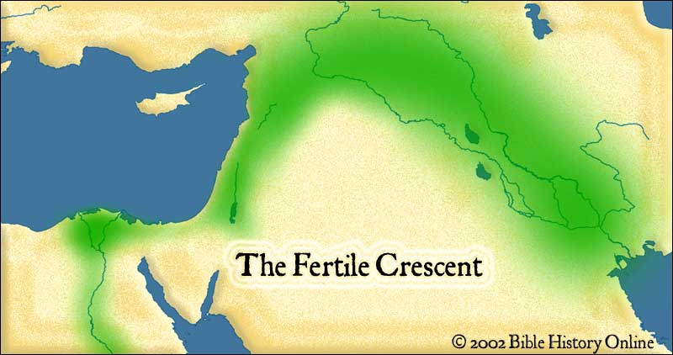
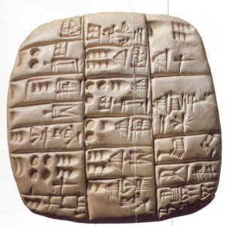
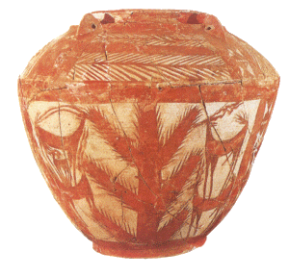

Section 1
Mesopotamia means, “The land between the rivers”
The oldest civilization was found in this region between the Tigris and Euphrates Rivers in what is now Iraq.
This area was part of the Fertile Crescent. A fertile arc of land from the eastern coast of the Mediterranean Sea to the Persian Gulf (Arabian Gulf)

Slide 7
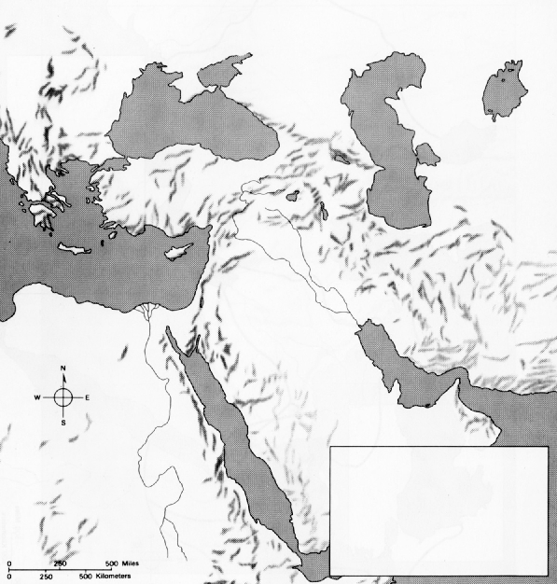
Mesopotamia is formed by the Tigris and Euphrates Rivers.
These rivers empty into the Persian Gulf
Aral Sea
Black Sea
Caspian Sea
Mesopotamia
Tigris
Mediterranean Sea
The other major river of this region is the Nile River in Egypt
Euphrates
Red Sea
Persian Gulf
Other bodies of water include:
The Mediterranean Sea,
Black Sea,
Caspian Sea,
Red Sea,
And Aral Sea
Nile

Slide 8
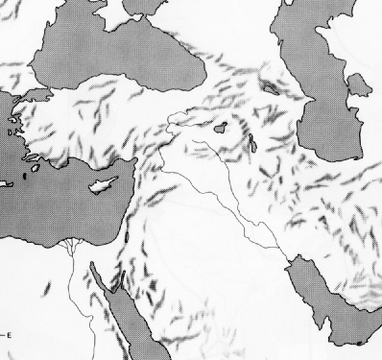
Lifestyle and Agriculture
The Tigris and Euphrates rivers would flood and deposit a rich layer of soil called silt.
Rich soil and a lot of crops helped lead to the development of civilization
Fertile Crescent

Slide 9
Regions
Sumer
First civilization, in
S. Mesopotamia
Akkad
To the north
Assyria
Further North
City States of Ancient Mesopotamia
Ur, Uruk:
City States
A city and its surrounding territory.
The cities were surrounded by great walls to offer protection.
Stone was scarce, so most building were made of mud bricks.
Assyria
Akkad
Babylon
Sumer
Ur

Slide 10
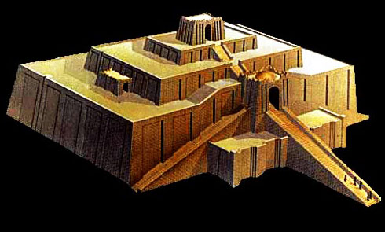

Gods, Goddesses, and Rulers
The most important building in the city state was the Ziggurat.
The Ziggurat was a massive stepped tower with a temple in the top of it.
The temples were also made of mud bricks.
The top layers of the bricks were baked in ovens so they could hold up if it rained.
The bottom layers were baked in the sun.
Priests and Priestesses: The Mesopotamian ziggurats were not places for public worship or ceremonies. They were believed to be homes for the gods. Through the ziggurat the gods could be close to the people and each city had its own patron god.
Only priests were permitted on the ziggurat, it was their responsibility to care for the gods and attend to their needs. As a result the priests were very powerful members of Sumerian society.
The Sumerians had a gloomy view of life. They believed it was their duty to serve the gods. If the gods were not happy then they would be punished by a flood or natural disaster. The flooding of the Tigris and Euphrates rivers was unpredictable and so the Sumerians lived in constant fear.

Slide 11
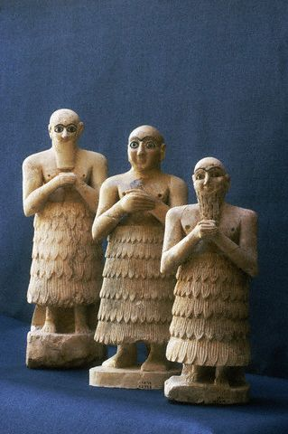
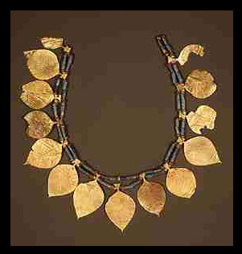

Theocracy The Sumerians believed that the gods ruled their cities. Rule by religious authority is called a Theocracy.
Divine Rulers The Sumerians believed that their kings got their powers to rule from the gods and that they had god-like powers themselves.
Kings were responsible for running vital irrigation projects, leading armies in battle, and running the affairs of the government. They were aided by priests and other government officials.
Economy and Society
Agriculture/Trade: The economy of ancient Sumer was based on Agriculture and Trade.
Metalworking: The Sumerians were known for working with copper, tin & gold. They traded these metal goods with other city states.
Social Divisions
There were three social groups: Nobles, commoners, and slaves.
Commoners included farmers, merchants, fishers, and craftspeople.
90% of people were farmers.
Slaves worked for nobles in the palace and for nobles on large farms.

Slide 12
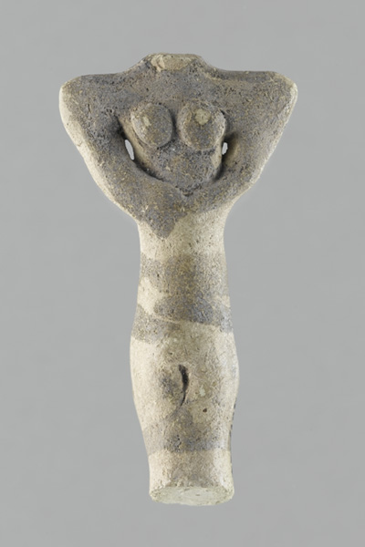
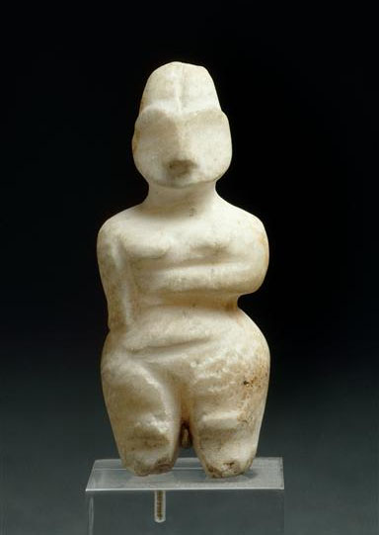
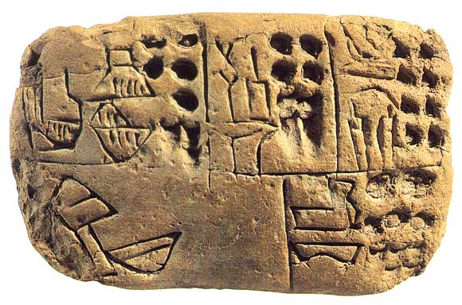
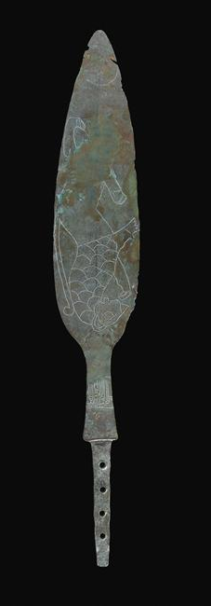
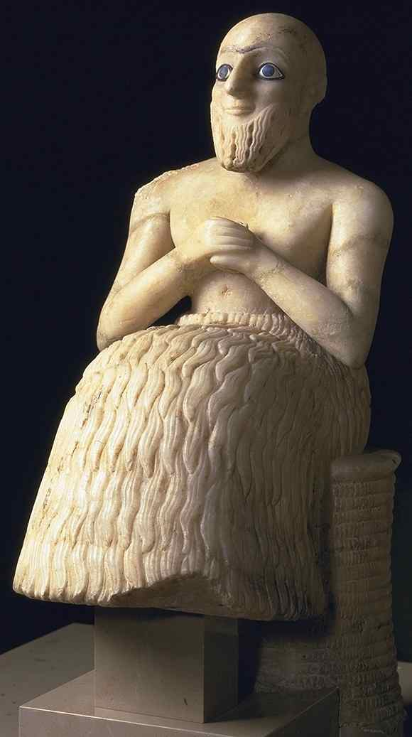
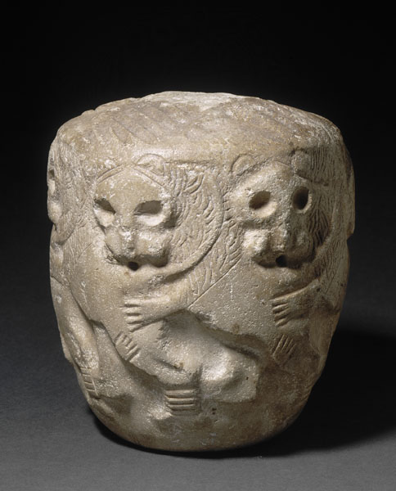
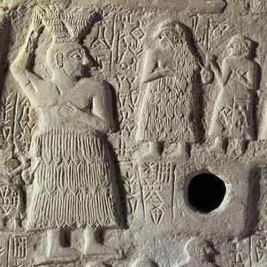


Slide 13
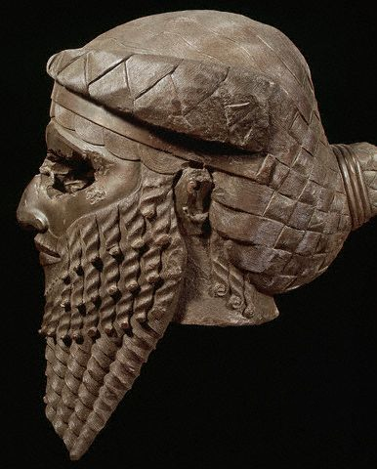
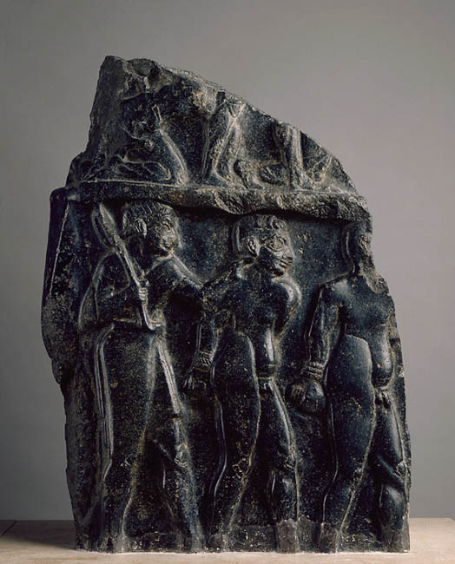
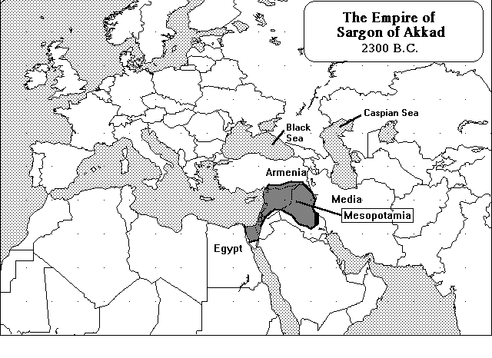

Empires in Ancient Mesopotamia
A Semitic-speaking people.
Around 2340 B.C., Sargon, leader of the Akkadians established the first Empire.
Sargon was the first Empire builder.
An EMPIRE is a large political unit, or state, with a single leader.
By 2100 BCE the Akkadian Empire fell after a series of battles

Slide 14
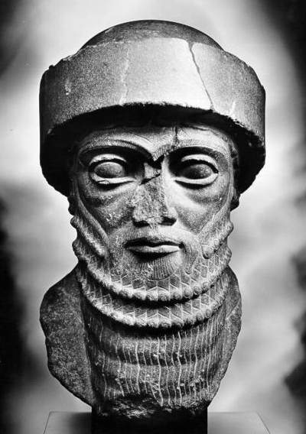
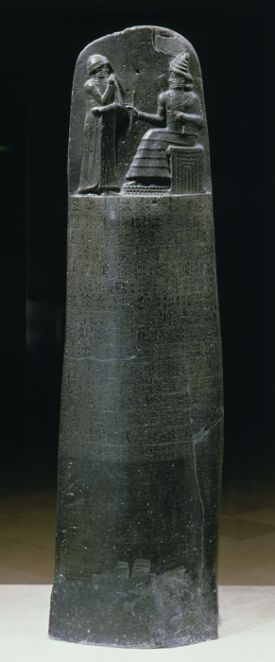

By 1792 BCE a new empire arose in this region.
The city-state of Babylon rose to power led by king
Hammurabi.
The Empire fell shortly after his death in 1750 BCE, but Hammurabi made significant contributions before his death.
Hammurabi codified and collected the laws of his region and wrote them down for all to see.
This is called HAMMURABI’S CODE, or the Code of Hammurabi.
He wrote them down so everyone would know what the laws were and could not use ignorance as an excuse to escape justice.
The law code covered just about everything from business to personal law and is seen as very harsh now, but was pretty standard for its time.
Babylon was Patriarchal, male dominated, but it did have some laws to protect women.

Slide 15
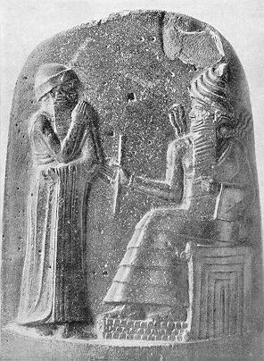

What should be done to the carpenter who builds a house that falls and kills the owner?
Code 229: If a builder builds a house for a man and does not make its construction sound, and the house which he has built collapses and causes the death of the owner of the house, the builder shall be put to death.
230 If it kill the son of the owner the son of that builder shall be put to death.
231 If it kill a slave of the owner, then he shall pay slave for slave to the owner of the house.
What should be done when a "sister of god" (or nun) enters the wine shop for a drink?
Code 110: If a "sister of god" (nun) who is not living in a convent opens a wine shop or enters a wine shop for a drink, they shall burn that woman.
What happens if a man is unable to pay his debts?
Code 117: If a man be in debt and is unable to pay his creditors, he shall sell his wife, son, or daughter, or bind them over to service. For three years they shall work in the houses of their purchaser or master; in the fourth year they shall be given their freedom.

Slide 16
What happens to the wine seller who fails to arrest bad characters gathered at her shop?
Code 108: If bad characters gather in the house of a wine seller and she does not arrest those characters and bring them to the palace, that wine seller shall be put to death.
What should be done about a wife who ignores her duties and belittles her husband?
Code 143: If the woman has not been careful but has gadded about, neglecting her house and belittling her husband, they shall throw that woman into the water.
What should be done if a son is adopted and then the birth-parents want him back?
Code 185: If a man takes in his own home a young boy as a son and rears him, one may not bring claim for that adopted son.

Slide 17
What should happen to a boy who slaps his father?
Code 195: If a son strikes his father, they shall cut off his hand.
How is the truth determined when one man brings an accusation against another?
Code 2: If any one bring an accusation against a man, and the accused go to the river and leap into the river, if he sink in the river his accuser shall take possession of his house. But if the river prove that the accused is not guilty, and he escape unhurt, then he who had brought the accusation shall be put to death, while he who leaped into the river shall take possession of the house that had belonged to his accuser.
Different treatment for people of different classes
196 If a man put out the eye of another man, his eye shall be put out.
200 If a man knock out the teeth of his equal, his teeth shall be knocked
out.
201 If he knock out the teeth of a freed man, he shall pay one-third of a
gold mina.

Slide 18
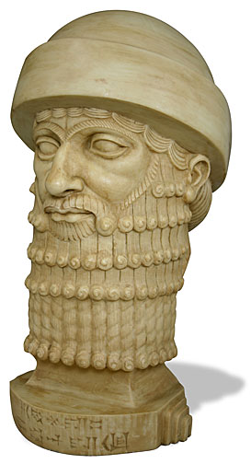
Social Responsibility
21 If any one break a hole into a house (break in to steal), he shall be put to death before that hole and be buried.
22 If any one is committing a robbery and is caught, then he shall be put to death.
23 If the robber is not caught, then shall he who was robbed claim under oath the amount of his loss; then shall the community, and . . . on whose ground and territory and in whose domain it was compensate him for the goods stolen.
25 If fire break out in a house, and some one who comes to put it out cast his eye upon the property of the owner of the house, and take the property of the master of the house, he shall be thrown into that self-same fire.

Slide 19
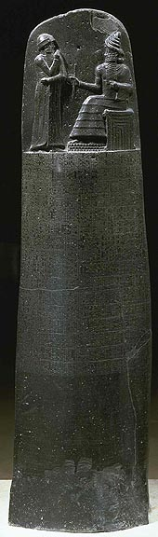
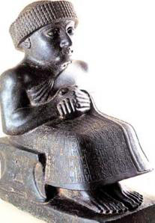
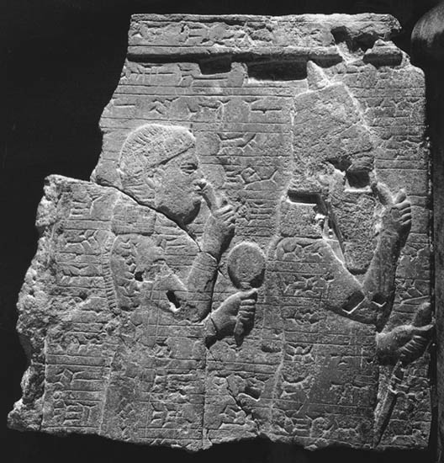
Art of Ancient Babylon

Slide 20
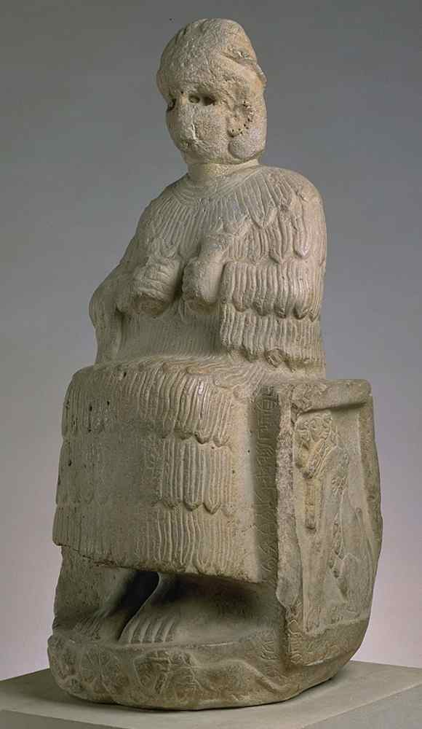
Importance of Religion
View of Afterlife
The Mesopotamians believed that they were put on earth to do the work that the gods did not want to do themselves.
They felt helpless in the face of nature
Their view of the afterlife was gloomy as well, they believed that the afterlife was very similar to their life on earth.
Polytheistic They believed in many gods
Anu: Chief god, god of the sky. He judged those who had committed crimes, and created the stars as soldiers to destroy the wicked
Enlil was the god of wind, or the sky between earth and heaven
Enki the deity of crafts, water, intelligence, and creation
Ninhursag earth and mother-goddess
Ninhursag

Slide 21
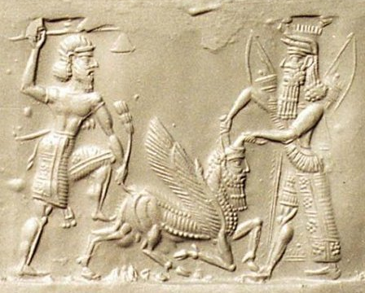
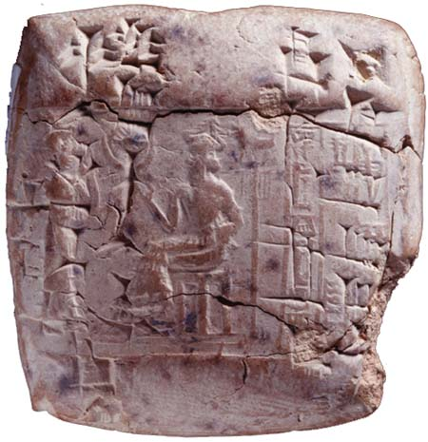
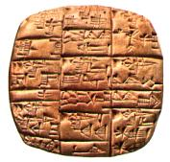
Sumerian Literature
The Epic of Gilgamesh
The first great epic poem
This is the story of a boastful and greedy king who
is put in his place by the gods.
It is thought to have influenced Hebrew writings
because it contains references to a flood myth.
Also tells of Gilgamesh's quest for eternal life. He finds the secret to paradise and eternal life which is stolen by a snake. This parallels the Hebrew story of Genesis and the garden of Eden.
Cuneiform
This was the first written language, its name means wedge shaped writing. It was invented by the Sumerians.
Writing was originally created as a way to keep records for agriculture and trade, but eventually was used for art and literature.
There was no paper so pictograms and characters were carved into clay tablets using a tool called a stylus made from a stick or reed.
Some cuneiform was later carved into stone.
Scribes were people who were trained to write

Slide 22
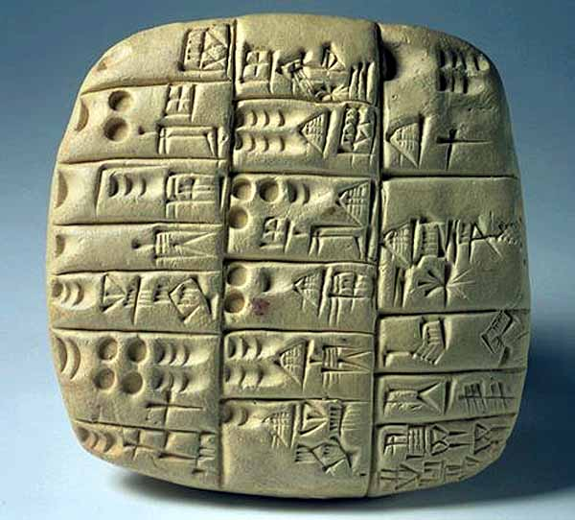
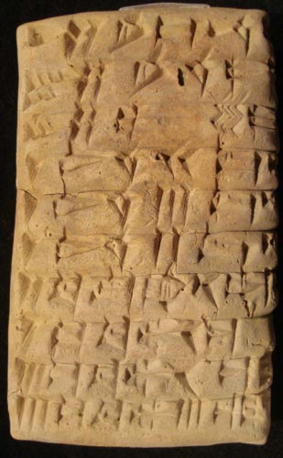

Slide 23

Sumerian Technology
The Sumerians were the first to do a lot of things
Wheeled Vehicles:
They were the first to take the wheel and use it for carts to transport goods and people.
They invented the potter’s wheel for making pottery
They were the first to make Bronze.

Slide 24
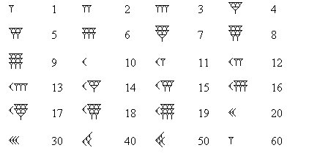
Sumerian Mathematics
The Sumerians invented a number system based on 60.
We still see the influences of this today in our time system and Geometry.

Slide 25
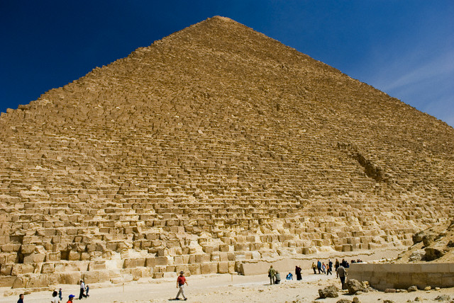
Section 2
Ancient Egypt
"The Gift of the Nile"

Slide 26
The Geography of Ancient Egypt
Egypt is located on the Nile River
The Nile begins in the Highlands of Ethiopia with two branches:
The White Nile and the Blue Nile
These rivers unite and flow north where they empty into the Mediterranean Sea.
Where the river empties into the Mediterranean it forms the Nile Delta, a rich area of alluvial soil.

Slide 27
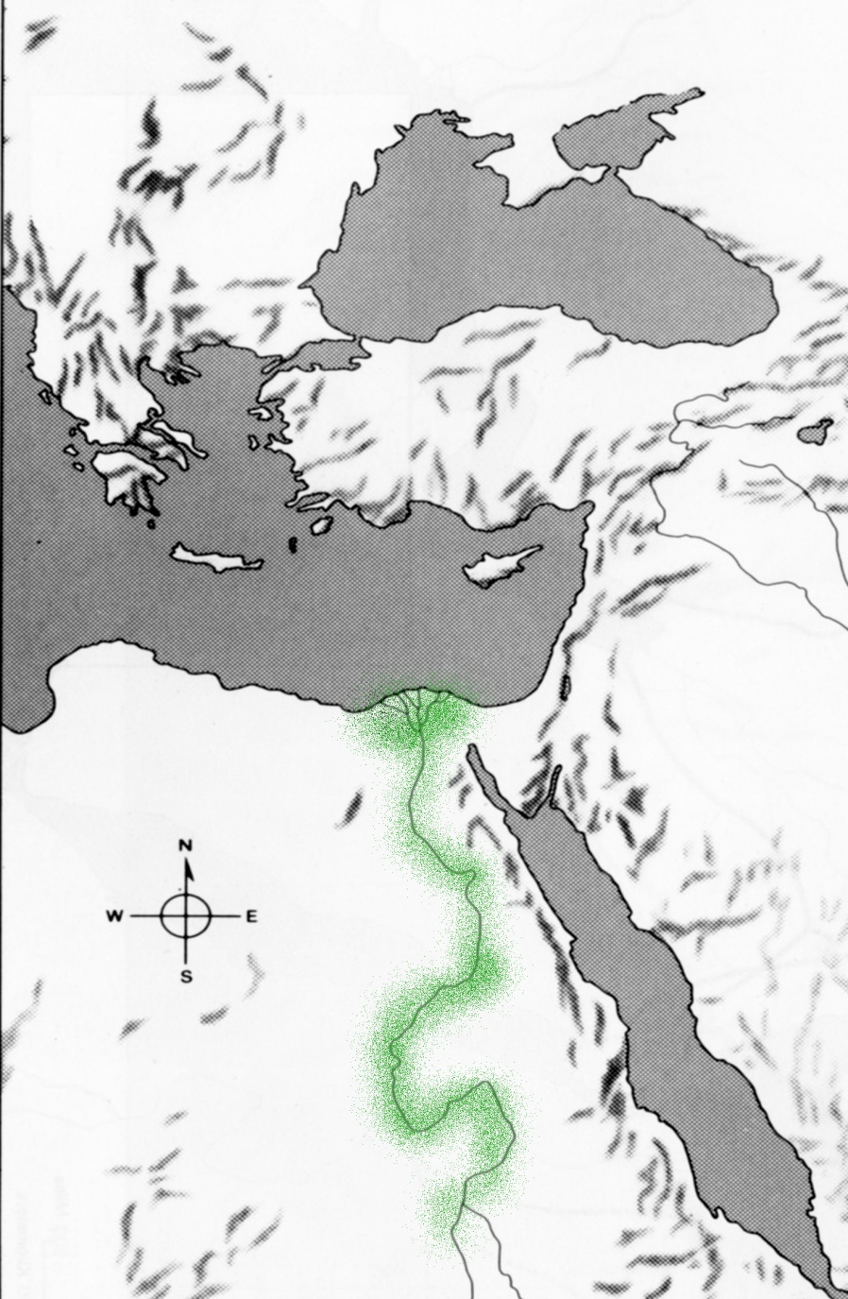

The most important thing to the Egyptians about The Nile was the yearly flooding.
The Nile would flood each year in the spring. With the flood it would deposit a rich layer of silt, or soil on either side of the river.
The rich soil around the Nile was called the Black land. The desert was called the Red Land.
Mediterranean Sea
Western Desert
Egypt had several natural barriers which helped to protect it from invasion
Red Sea
These barriers gave Egyptians a sense of security that was lacking in much of the ancient world.

Slide 28
Egyptian Religion
For the Egyptians, religion was closely tied to daily life.
The Egyptians were polytheistic, worshipping many different gods.
The most important god was the god of the sun, Re, also sometimes referred to as Ra or Amon-Re.
It was believed that the Pharaoh was connected to this god.

Slide 29
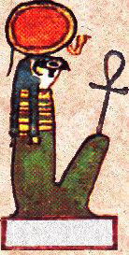
Egyptian Deities
Re (Ra)
The Chief Egyptian god. Was seen as the god of the sun.
Anubis was the patron of embalming. He was also the keeper of poisons and medicines. Anubis performed the Opening of the Mouth ceremony which was performed at the funeral to restore the senses of the deceased. The ceremony was done by touching the mouth of a mummy or statue of the deceased, it was believed to restore the senses in preparation for the afterlife.

Slide 30
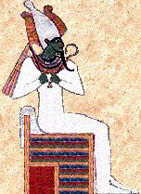
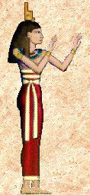
Osiris Supreme god and judge of the dead. The symbol of resurrection and eternal life. Provider of fertility and prosperity to the living.
Isis As a winged goddess she may represent the wind, she was the wife of Osiris. In the Osiris legend there are references to Isis wailing and moaning like the wind. She restores life to Osiris by flapping her wings and filling his mouth and nose with air.
Isis was a great enchantress, the goddess of magic. She was the embalmer and guardian of Osiris. She is often rendered on the foot of coffins with long wings spread to protect the deceased.

Slide 31
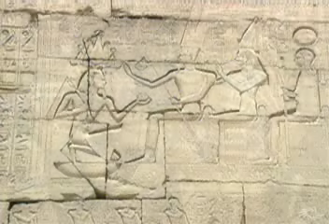
Horus was the son of Osiris (The god of the Dead) and Isis. It was said that he avenged the death of his father he was considered to be the model of a dutiful son
The Ka
It was believed that each person had a Ka, or soul. The practice of mummification began because it was believed that the soul could exist in the afterlife only so long as the body was preserved

Slide 32
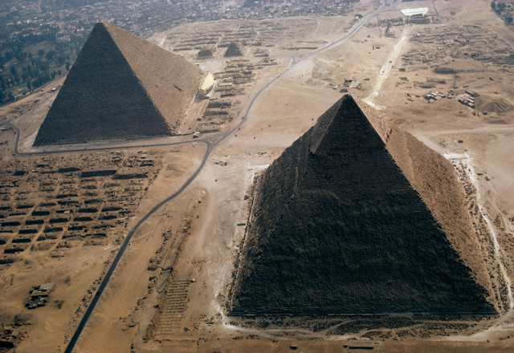
Egyptian History
Egyptian History is divided into three main periods
The Old Kingdom
The Middle Kingdom
The New Kingdom

Slide 33

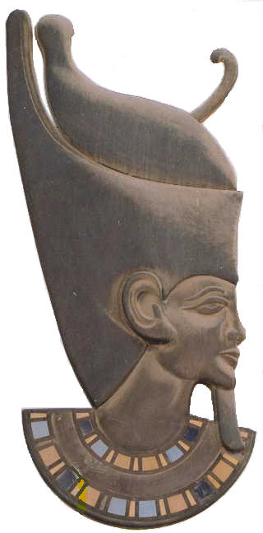
The History of Egypt begins with Menes
Menes Unites upper Egypt and Lower Egypt, joining the two into a united kingdom
In doing this, Menes establishes the first Egyptian Dynasty
Lower Egypt
Upper Egypt

Slide 34
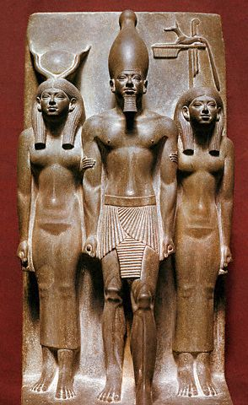
The Old Kingdom 2700-2200 B.C.
The Old Kingdom was a period of great prosperity.
This time is also called the pyramid age, because the great pyramids were built during this time.
Egyptian kings were called Pharaohs.
The Pharaoh was seen as divine, or godlike. The people believed that the Pharaoh controlled many things including the flooding of the Nile itself.
The Pharaoh wielded absolute power, but used advisors to help them.
The Chief advisor to the Pharaoh was the Vizier.

Slide 35
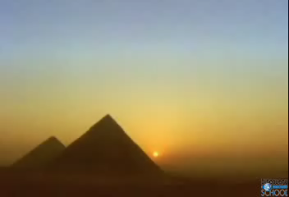
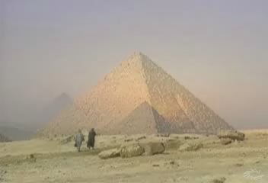
The Pyramids
Pyramids were built during the Old Kingdom
They were designed to be tombs for the Pharaoh
Originally there were step pyramids, then the pyramids evolved into the ones we see at Giza
The Pyramids were designed to protect the mummies of the Pharaohs, but they ultimately failed. They were robbed and pillaged.

Slide 36
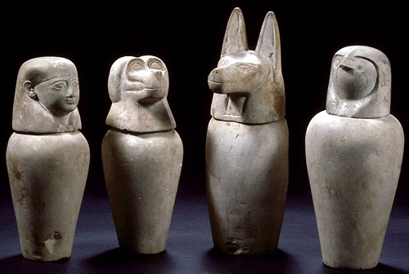
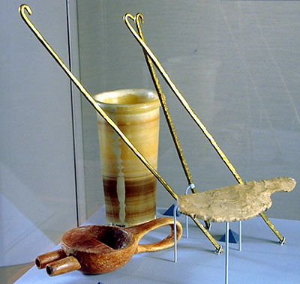
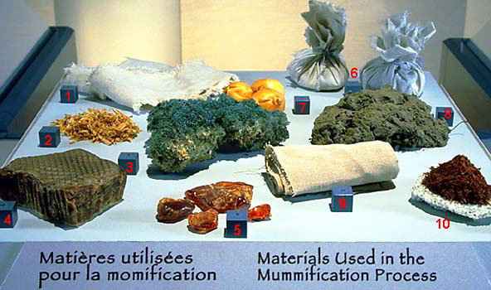
Mummification
To preserve the body so that the soul could stay in the afterlife, the Egyptians perfected the process of mummification. Mummification was expensive, however, and during the Old Kingdom was a luxury of the rich.
First the body was washed and the internal organs including the lungs, stomach, liver and intestines were removed. The heart was left in the body because the Egyptians viewed it as the center of emotion.
The Brain was removed through the nose and thrown away. The Egyptians didn’t think it served any purpose
The Body was packed in Natron (a drying agent) and left for 70 days. After that the body was wrapped in linen with tree resin for glue. Magical amulets and other treasures were buried with the body.

Slide 37
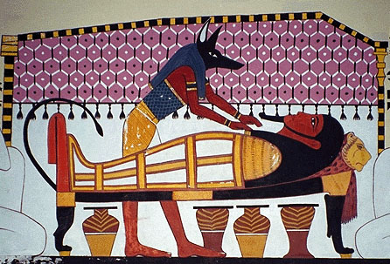

Slide 38
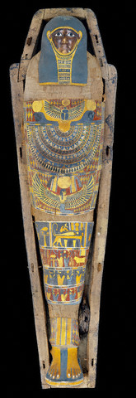
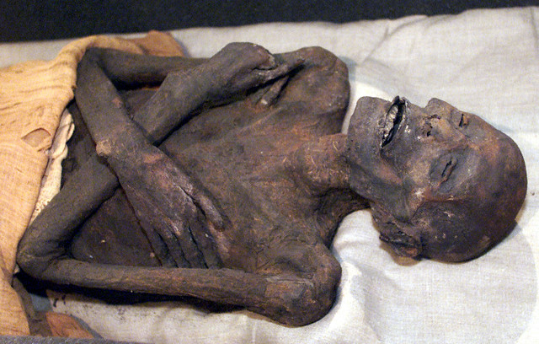



Mummies

Slide 39
The Middle Kingdom
2050-1652 B.C.
After the fall of the Old Kingdom there was a period of chaos for about 150 years
A new dynasty took over in Egypt, bringing a period of stability.
Egypt expanded into Nubia to its south.
The government also sent troops into Palestine and Syria and sent traders to Kush, Syria, Mesopotamia, and Crete
In the Middle Kingdom the Pharaoh took new interest in the common people. The Pharaoh also implemented many public works projects.

Slide 40

The New Kingdom
1567-1085 B.C.
The Middle Kingdom ended with the invasion of a people called the Hyksos
The Hyksos had Chariots and superior weapons to the Egyptians. The Egyptians were easily defeated.
Eventually the Egyptians overthrew the Hyksos and established the
New Kingdom
The Pharaohs of the New Kingdom took a more aggressive ruling style
Egypt became the most powerful state in Southwest Asia

Slide 41




Hatshepsut
Hatshepsut was the first woman to be Pharaoh
She was originally supposed to be regent, but took power for herself
She had to pose as a man to cement her authority.
She built many monuments and temples.

Slide 42

Akhenaton
Akhenaton wanted Egypt to worship the god of the sun, Aton, as the only god.
He closed all of the temples to the other gods and caused major social and political problems. He and his wife, Nefertiti, become unpopular rulers.
After his death Tutankhamen (King Tut) restored the old ways of worship.

Slide 43




King Tut:Tutankhamen
Became Pharaoh after the death of Akhenaton.
Restored the old religious practices
Has the only tomb to be found intact

Slide 44


Ramses II
(The Great)
Ramses II, reigned from 1279 until 1213 B.C. One of the longest reigns in Egyptian History
He sought to increase the size of the empire and went on many military conquests, but he was unsuccessful. He was only able to gain the area of Palestine.
He fathered over 100 children
Some think that he is the Pharaoh of the Hebrew Exodus

Slide 45




Abu Simbel: Temple of Ramses the Great

Slide 46

Decline
Egypt fell into a period of decline and foreign invasion.
Egypt was ruled by many different people and eventually defeated by the Romans.
The last Pharaoh of Egypt was Cleopatra VII, who committed suicide rather than surrender to the Romans.

Slide 47

Daily Life
The people had a positive attitude toward life.
Monogamy was the rule, and women had more rights in Ancient Egypt than the rest of the Ancient world.
Women could own property, business, and request a divorce.
Egyptian Society
Egypt had a hierarchical
social structure
Pharaoh
Priests
Nobles
Merchant Class
Peasants and Slaves

Slide 48

Hieroglyphics
Writing began in Egypt around 3000 B.C.
There were different types of writing for different occasions.
Hieroglyphics were ideograms used for formal writing
Hieratic Script (Demotic) was a simplified version of Egyptian writing.
The Egyptians carved their writing on stone, or wrote on papyrus, a form of paper made from a reed that grew along the Nile River.

Slide 49



Slide 50

The Rosetta Stone
For a long time archaeologists were unable to translate hieroglyphics
The discovery of the Rosetta stone allowed for the translation of Hieroglyphics
It contained the same passage in three languages
Hieroglyphics
Greek
Demotic

Slide 51

Egyptian Art
In Egyptian art the human body is usually shown in profile or partial profile

Slide 52

Egyptian Advancements in
Math and Science
The Egyptians used math to calculate area and volume in building the pyramids and in surveying flooded land for farming
The Egyptians developed an accurate solar (365 day) calendar.
The practice of mummification and embalming led to advances in medical knowledge including how to set broken bones, wounds, and disease.

Slide 53





Egyptian
Monuments
Step Pyramid of Zoser
Obelisk of
Hatshepsut
Sphinx and Pyramids
At Giza

Slide 54



Slide 55

Pastoral Nomads
Nomadic peoples who lived in the areas surrounding the
great civilizations of the ancient Middle East.
They domesticated animals for food and clothing and
moved along regular migratory routes.
They did trade with the settled peoples of the area and
helped to establish long-distance trade networks. This also allowed for the spreading of culture and technology (Cultural Diffusion)
Indo-Europeans
From steppe region north of the Black Sea.
Their language influenced Greek, Latin, Persian, Sanskrit, and Germanic languages.
Some of these people settled in Anatolia around 1750 B.C. and helped to establish the Hittite Kingdom.

Slide 56



The Hittites created their empire between 1600-1200 B.C. (BCE)
*They were the first people to learn to smelt (separate metal from ore) iron.
There were eventually weakened and defeated by the Sea Peoples.
The Sea Peoples is the term used for a mysterious confederacy of seafaring raiders who sailed into the eastern shores of the Mediterranean, invaded Cyprus, and the Levant, and attempted to enter Egyptian territory
The end of the Hittite kingdom allowed for the rise of other people in this region

Slide 57




The Hittite capital city of Hattusha

Slide 58




Lived: The Phoenicians established a trade empire, and colonies, throughout the Mediterranean.
Made Living: They traded many goods including glass and lumber.
Goods: Their most important product was Tyrian purple, a dye made from boiling the Murex snail.
This purple dye was very difficult and expensive to produce. It was very valuable to the rich.
Murex snail

Slide 59


Slide 60

The Phoenicians spread their alphabet throughout the Mediterranean
Their alphabet consisted of 22 letters, it did not have vowels.
Unlike many early alphabets which were made of pictograms, the Phoenician alphabet was phonic (based on sound). These sounds could be assembled to make words.
The Greeks eventually adopted this alphabet, which influenced the Latin Alphabet which we use today.

Slide 61


Phoenician Writing

Slide 62


Phoenician Artifacts

Slide 63






Slide 64


Israelites
Semitic-speaking people who lived
south of the Phoenicians in
the Levant.
Compared to other groups in the region,
they were a small group.
Their religion, known today as Judaism, continues as a world religion and influenced the development of Christianity and Islam.

Slide 65
History of the Hebrews
Abraham
Abraham is seen as the Patriarch, or father, of Judaism as well as Christianity and Islam.
According to Jewish tradition Abraham is brought by God from his home in the ancient city of Ur into a new land, Canaan (the holy land), where he enters into a covenant (agreement) with God:
in exchange for sole recognition of Yahweh as supreme universal authority, Abraham will be the father of a great nation.

Slide 66

Exodus
The escape of the Israelites from their captivity in Egypt.
Moses was the leader of the Hebrew Exodus. The story goes that the Hebrew God had to curse Egypt with 10 plagues in order for the Pharaoh (Ramses II) to free the Israelites.
10 Plagues
The Nile turned to blood
Frogs
Fleas and Lice
Flies
Epidemic disease which exterminated the Egyptian livestock.
Boils
Storm (Hail)
Locusts
Darkness
Death of the first born son
(Passover Holiday comes from this event)
According to the Torah, the Israelites disobeyed
God and wandered the desert for 40 years
before reaching the holy land.

Slide 67



King Solomon 970-930 BCE
United the tribes of Israel into the Kingdom of Israel
Solomon was the son of King David, and was known as a wise king.
During this time Jerusalem
became the capital of the
Kingdom of Israel
Under the leadership of Solomon,
Israel reached the height of its power.
He built a great temple in Jerusalem which
became the focal point of the Jewish Religion.
The remains of this temple, now known as the
Western Wall or Wailing Wall are still a focal
point of the Jewish faith.

Slide 68

The Divided Kingdom
After Solomon’s death the kingdom of Israel split into two parts
Division: The Kingdom of Israel was the ten northern tribes with the capital city of Samaria.
The Assyrians destroyed the kingdom of Israel and scattered the people in 722 B.C., these are known as the lost tribes of Israel.
The Kingdom of Judah was the two tribes in the South with the capital of Jerusalem.
The Kingdom of Judah remained until it was
destroyed by the King Nebuchadnezzar in
586 B.C.
This event the Babylonian captivity which would last until
the defeat of the Chaldeans by the Persian
Empire and Cyrus the Great. This ended the first diaspora.

Slide 69

The Babylonian Captivity of the Jews was known as the first Diaspora.
The Diaspora is the scattering of the Jewish people.
There have been two Diasporas.
The first was the Babylonian captivity, which ended when the Persians freed the Jews and the Jews returned to Jerusalem and rebuilt the temple.
During the Captivity there was an Age of Prophecy
The Prophets such as Isaiah and Ezekiel
The prophets declared that the people
needed to return to the original
covenant or face punishment.

Slide 70
The Jews stayed in Israel until the Romans destroyed the Temple again in 70 CE beginning the second Diaspora.
After that the Jews were scattered throughout Europe.
European anti-Semitism in the Middle Ages and the Holocaust of WWII forced many Jews to emigrate to the United States and many began to return to Israel.
This led to the formation of the state of Israel by the United Nations in 1948 ending the second Diaspora. Many Jews consider any Jew not living in the Holy Land to still be in the Diaspora.

Slide 71

Monotheism: Judaism was the first religion to worship only One God. The Jews viewed Yahweh as being all-knowing (Omniscient), and all-powerful (Omnipotent)
Yahweh: The Jewish name for God. Jews view this name as sacred and will not say the full name or write the name out. They will use abbreviations in writing, or say another name for God when speaking of God.

Slide 72


Covenant: Jews believe that Abraham made a Covenant, or Agreement with God that he and his descendants would have no other God.
Obligations:
-Jews promised not to worship any other God.
to practice Bris
-The Jews promised , or Circumcision, as a symbol of the Covenant.
-In exchange the Jews believe that God promised them Canaan, or the Holy land.

Slide 73





The term people of Israel refers to the descendants of Abraham through his son Isaac, and his Son Jacob who became known as Israel. Jacob was name Israel after he struggled with an angel and won, it means he who prevails with God."
The Torah is the holy book of Judaism, the laws of the Jewish people.
It is the first five books of the Christian Bible
The Torah is also known as the Five Books of Moses or the Pentateuch
Books written to explain and interpret Jewish law

Slide 74



The Jewish people view history as having a purpose.
They believe that everything that happens, does so because it is part of their God’s ultimate plan.
Bris ceremony within Judaism that welcomes infant (8 days old) Jewish boys into a covenant between God and the Children of Israel through ritual circumcision performed by a mohel ("circumcisor") in the presence of family and friends.

Slide 75

According to Jewish law, when Jewish children reach the age of maturity (12 years for girls, 13 years for boys) they become responsible for their actions. At this point a boy is said to become Bar Mitzvah one to whom the commandments apply.
A girl is said to become Bat Mitzvah
Before this age, all the child's responsibility to follow Jewish law and tradition lies with the parents.

Slide 76


Shiv'ah is the name for Judaism's week-long period of grief and mourning for the seven first-degree relatives: father, mother, son, daughter, brother, sister, or spouse; grandparents and grandchildren are not included
Rabbi
A Rabbi is a teacher of the Torah.
Phylactery
Boxes that contain certain verses from the Torah.

Slide 77

Shabbat is the weekly day of rest in Judaism. It is observed, from before sundown on Friday until after nightfall on Saturday.
During this time no work is supposed to be done.
Yom Kippur
A Jewish Day of Atonement (Asking for forgiveness). It is 25 hours of prayer and fasting. Although the fast is required of all healthy adults, fasting is specifically forbidden for anyone who might be harmed by it.

Slide 78

Passover commemorates the Exodus and freedom of the Israelites from ancient Egypt.
Hanukkah
Jewish Holiday often called the Festival of lights. It celebrates the rededication of the Temple of Jerusalem.
The Jews had only enough lamp oil to burn for one day, but it lasted 8 days, which was enough time to make and bless more lamp oil.
Menorah and Dreidel

Slide 79



The Western (Wailing) Wall in Jerusalem
The most important of all Jewish monuments
It is the remnants of the Temple of Solomon after its destruction by the Romans in 70 A.D.

Slide 80



Slide 81



New Empire
Semitic-speaking people who exploited the use of iron weapons to build an empire by 700 B.C.
Semitic-Speaking
Spoke Semitic language
Included terrirotry from: Mesopotamia, some of the Iranian Plateau, Asia Minor, Syria, Palestine, and Egypt.

Slide 82

Eventually Fell
Eventually, the Assyrian Empire fell to several groups including the Chaldeans (Neo-Babylonians) and the Medes.
Assyrian Rulers
Assyrian kings ruled with absolute power.
Kingdoms were well organized and efficient.
Kept direct contact with the people who helped administer their empire
Transportation/Courier system
They est. a system where they could relay messages by horseback back and forth in a week’s time.
Ashurbanipal
Considered the greatest Assyrian King.
He collected the writings of Mesopotamia and est. the great library of Nineveh

Slide 83





Nineveh: The Assyrian Capital

Slide 84


Military Strength
The Assyrian military was one of the strongest in the ancient world.
They used fierce iron weapons and psychological warfare.
The Assyrians would often attempt to get an area to surrender before attack.
If people refused and were defeated they were treated harshly.
King Ashurnasirpal once stated
“3,000 of their combat troops I felled with weapons . . . Many I took alive; from some of these I cut off their hands to the writs, from others I cut off their noses, ears and fingers; I put out the eyes of many of the soldiers. . . . I burned their young men and women to death.”

Slide 85



The Assyrian empire eventually fell and the Chaldeans (Neo Babylonians) under king Nebuchadnezzar who made Babylon the most powerful state in the region.
Nebuchadnezzar is most famous for the construction of the Hanging Gardens of Babylon, considered one of the seven wonders of the ancient world.
He was also responsible for the destruction of the Temple of Jerusalem and beginning the Babylonian Captivity of the Jews and the first Diaspora.
Babylon is defeated and replaced by the Persian Empire in 539 B.C.

Slide 86






Slide 87



Cyrus the Great
Persian King who defeated Babylon and ended the Jews’ captivity.
Cyrus ruled from 559 to 530 B.C. and was a great leader, hence the name Cyrus the Great.
Ruling Style
He was very respectful (tolerant) of other cultures. Not only did he free the Jews, but he also treated conquered peoples fairly. He allowed them to keep their own religions and customs.
This respect made the people who lived under him respectful of his rule and less likely to revolt.

Slide 88



Expansion of Empire under Darius I
Ruled from 521-486 B.C. added western India to the Persian Empire.
Then added Thrace in Europe and expanded the Empire to its greatest size. He also brought the Persian Empire into conflict with the Greeks.
Satrapies
Darius divided his empire into provinces called
Satrapies to make it more manageable, this is
Called an Imperial Bureaucracy
Each province was ruled by a governor called a
Satrap.
This man was the protector of the kingdom.
They collected taxes, provided justice
and security, and got soldiers for the army.

Slide 89

The Royal Road

Slide 90


The Royal Road
The Royal road stretched from Lydia to Susa, the chief capital of the empire. It used a system of couriers similar to the Assyrians. This allowed for efficient communication in the empire
Persian Military
The Persians had an elite military. It contained people from all over the Persian Empire.
The Immortals
The Elite fighters of the Persian Empire.
They were so called because in battle their numbers were never allowed to fall below 10,000 men. They were constantly replaced from behind so they appeared to never die.

Slide 91


Persian kings became greedy and so the empire became weak.
Family spats and assassinations became the rule of the day.
The Empire was defeated by Alexander the Great during the 330’s B.C.

Slide 92







Slide 93






Slide 94



Zoroastrianism
Original Religion of the Persian Empire,
Was founded in the 6th century BCE
Zoroaster
Founder and Prophet of the Religion. Also known as Zarathustra.
Book: Zend Avesta, the recorded teachings of Zoroaster.
Monotheistic
Taught belief in one universal, all-powerful god.
Ahura Mazda
The god of Zoroastrianism

Slide 95
Beliefs:
There exists a universal God, Ahura Mazda, who is the one uncreated Creator and to whom all worship is directed. With the name being a playful combination of a masculine and a feminine word, it should be stressed that this divinity is not gender specific.
Creation is attacked by violence and destruction (The evil force is called Angra Mainyu ) . The resulting conflict involves the entire universe, including humanity, which has an active role to play in the conflict. Ahura Mazda will ultimately prevail, at which point time will end.
Active participation in life through good thoughts, good words and good deeds are necessary to ensure happiness and to keep the chaos at bay.
There is a concept of free will, to decide whether to perform good thoughts, words and deeds.

Slide 96

It is believed by many that Zoroastrianism influenced Judaism, and later, Christianity.
The religion teaches about an all-powerful God.
An ultimate battle between good and evil.
The idea of an evil being, or Satan.

