Slide 1
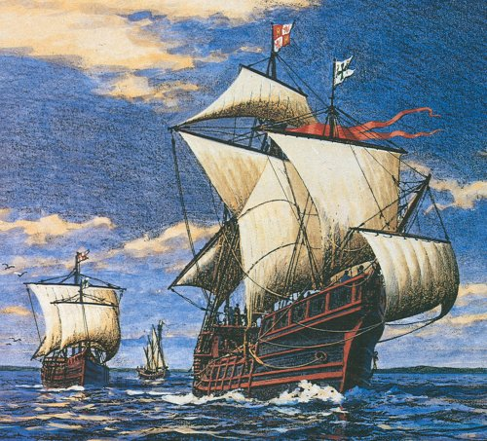
The Atlantic World

Slide 2
The Voyages of Christopher Columbus
Columbus sailed for Spain, heading west looking for an alternate route to Asia
October 1492, he lands on a Caribbean island (Bahamas?) and claims it and other islands for Spain
Columbus returned again in 1493, hoping to establish colonies (lands that are controlled by another nation)

Slide 3
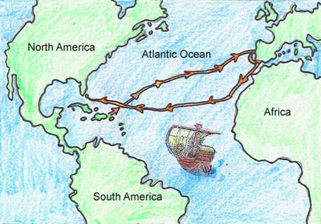

Slide 4
Other Explorers
1500 – Portuguese explorer Cabral reached Brazil
1501 - Amerigo Vespucci traveled along coast of S. America; realized it wasn’t Asia
1513 – Spanish explorer, Balboa, crosses Panama to the Pacific; first European to see Pacific
1519- Ferdinand Magellan sailed around tip of South America into Pacific; his crew arrived back in Spain in 1522 – the first people to circumnavigate the world

Slide 5
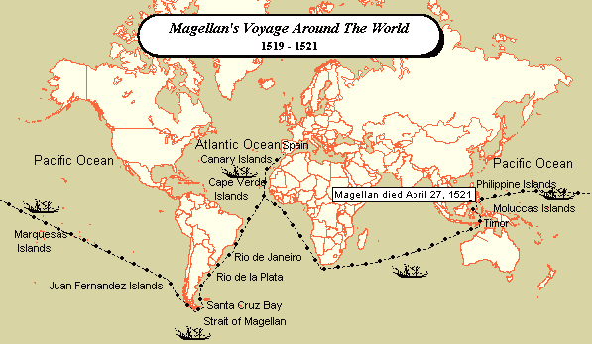

Slide 6
Spanish Conquests in Mexico
Spanish conquistadores (conquerors) looking for gold and silver were the first Europeans to settlers in the Americas
1519 – Hernando Cortés lands in Mexico; conquers the Aztecs with superior weapons, horses, help from other native groups who hated the Aztec (remember human sacrifices?), and disease
Diseases eventually killed millions of native people of central Mexico

Slide 7
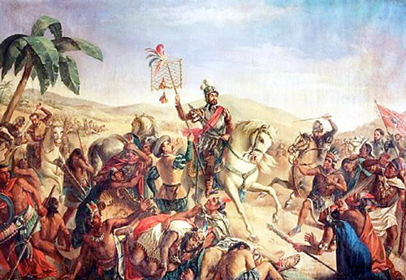

Slide 8
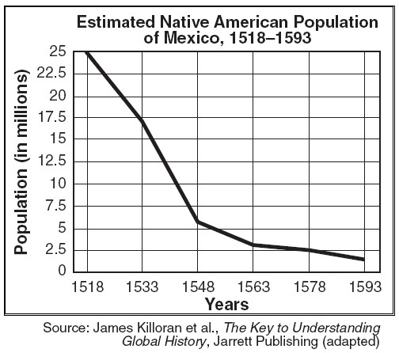

Slide 9
Spanish Conquests in Peru
1532 – Francisco Pizarro leads an army into Peru
Meets the Incan leader, Atahualpa, who is kidnapped and then killed
Pizarro’s army then conquers the Incan capital of Cuzco
Spanish explorers also conquer the Maya
By the mid-16th century, Spain had created an empire in the Americas

Slide 10
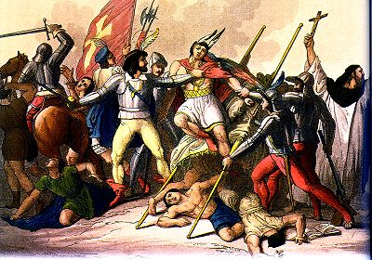

Slide 11
Spain’s Pattern of Conquest
Spanish settlers were called peninsulares
Descendants of the peninsulares and native women were mestizos (mixed Spanish and native American)
Spanish settlers imposed their culture on the native population
System of encomienda in which natives farmed or mined for Spanish landlords
Native workers often worked to death

Slide 12
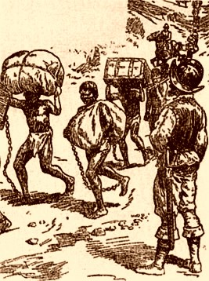
The Encomienda System

Slide 13
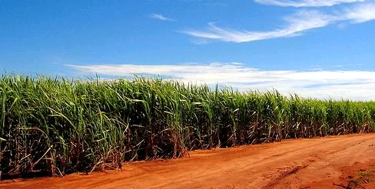
Cabral claimed Brazil for Portugal
Colonists began growing sugar which was in great demand in Europe

Slide 14
Opposition to Spanish Rule
Priests accompanied most conquistadors, hoping to convert the native population
Many priests spoke against the cruel treatment of natives
The Spanish government abolished the encomienda system in 1542; the colonies then looked to African slaves for labor
There were some scattered resistance attempts throughout the Americas against the Spanish

Slide 15
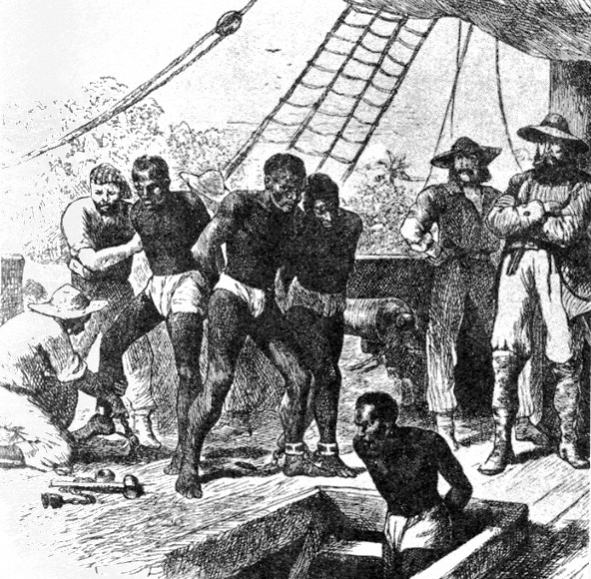
The Atlantic Slave Trade

Slide 16
The Causes of African Slavery
Slavery had existed in Africa (and elsewhere) for centuries; increased in Africa with spread of Islam in 7th c.
As native Americans began dying by the millions, Europeans turned to Africa. Why?
Some immunity to European diseases
Many Africans had experience in farming
Less likely to escape (didn’t know the new land)
Color made them easy to identify
The African slave trade (buying and selling of slaves for work in the Americas) lasted

Slide 17
The Atlantic Slave Trade
The Atlantic slave trade (buying and selling of Africans for work in the Americas) resulted in the import of 9.5 million Africans by the time it ended in 1870
Spain and Portugal led the way; later the English dominated the slave trade

Slide 18
The Triangular Trade
Triangular Trade – a transatlantic trading network
Leg 1 – European transported manufactured goods to the west coast of Africa; traded goods for captured Africans
Leg 2 – Africans were transported across the Atlantic (The Middle Passage) and sold
Leg 3 - Sugar, coffee, rum, and tobacco are shipped to Europe

Slide 19
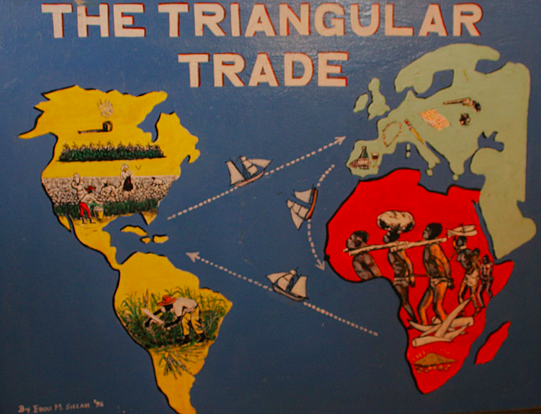

Slide 20
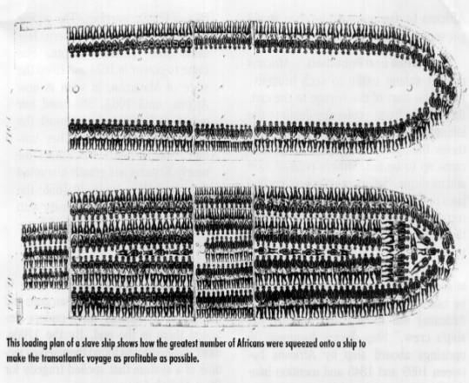
The Middle Passage

Slide 21
://www.youtube.com/watch?v=8nePOpkYwjY

Slide 22
Consequences of the Slave Trade
Impact on Africa
Numerous cultures lost their fittest members
Families torn apart
Many African societies devastated by the introduction on guns
Impact on Americas
Growth of the colonies
Economic AND cultural

Slide 23
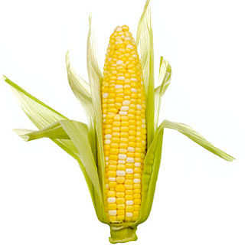
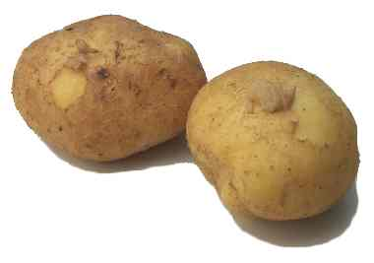
The Columbian Exchange and Global Trade

Slide 24
The Columbian Exchange
Columbian Exchange – the global transfer of foods, plants, and animals during the colonization of the Americas
Ships from the Americas (the New World) brought many items that people in Europe, Africa, and Asia (the Old World) had never seen
Ships to the Americas brought livestock and foods, but also diseases such as smallpox and measles which led to the deaths of millions of Native Americans

Slide 25
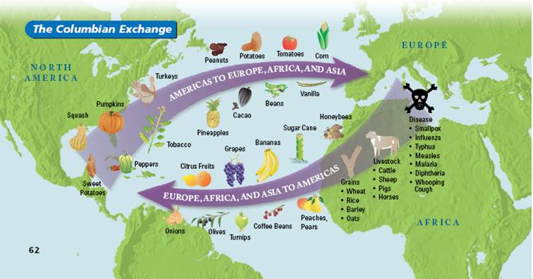

Slide 26
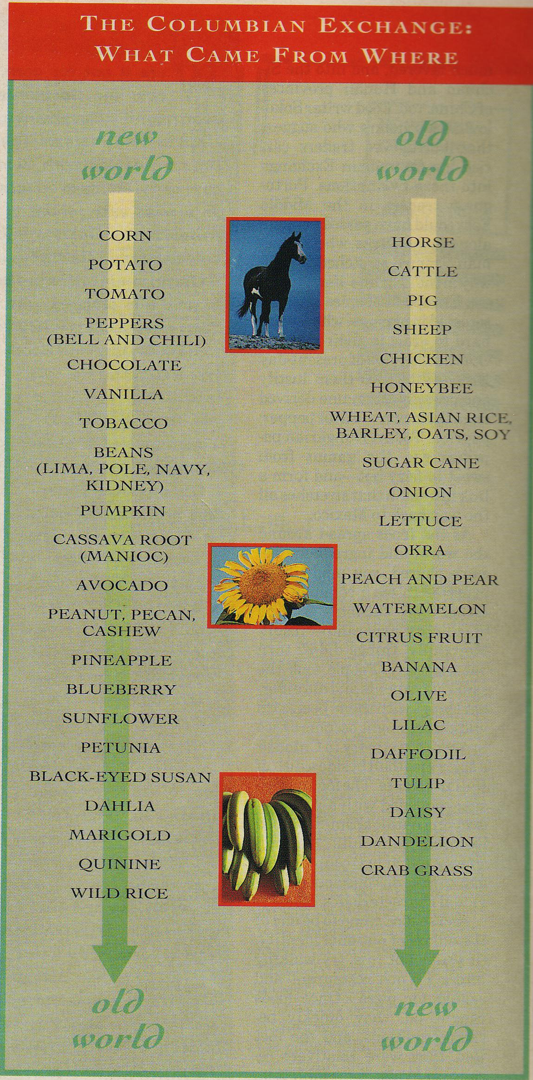

Slide 27
Corn and Potatoes
Most important items to travel from the New World to the Old
Inexpensive to grow and nutritious
Both became an important and steady part of diets around the world
Boosted the world’s population

Slide 28
Global Trade
Establishment of colonies in the Americas led to new wealth in Europe
Dramatic growth of overseas trade
Both contributed to new business and trade practices during the 16th and 17th centuries

Slide 29
The Rise of Capitalism
Capitalism – an economic system based on private ownership and the investment of resources, such as money, for profit
Governments no longer the sole owner of great wealth
Businesses grew and flourished as merchants became wealthy and invested their money in trade and overseas exploration
The more money they made, the more they reinvested in other enterprises

Slide 30
Joint-Stock Companies
Joint-Stock Company – works like a modern corporation
Investors buy shares in company
Many people combine their wealth for a common purpose
Purpose was colonization which took large amounts of money and involved a lot of risk
If colony failed, investors lost only their small share
If colony thrived, investors all shared in the profits
Example: Jamestown, England’s first colony in North America

Slide 31
The Growth of Mercantilism
A new economic policy was mercantilism
A theory that a country’s power depended mainly on its wealth, so the goal of every country became the attainment of as much wealth (gold) as possible

Slide 32
Balance of Trade
According to the theory of mercantilism, a country could increase its wealth in two ways
Obtain as much gold as possible
Establish a favorable balance of trade in which it sold more goods than it bought
Colonies were vital to mercantilism
Source of silver and gold
Provided raw materials not found in home country
Provided a market for for home country’s goods

Slide 33
COLONY
HOME COUNTRY
RAW MATERIALS
MANUFACTURED GOODS

Slide 34
Changes in European Society
The economic revolution spurred the growth of towns and the rise of wealthy merchant class
However, the majority of Europeans remained poor and lived in rural areas
The wealth of European nations increased
Contributed to the creation of national identities
Expanded the power of European monarchs

